Slide 1
Recursion
To err is human, to forgive divine.
To iterate is human, to recurse divine
Taken From
Chapter 5 of the Book by Adam Drozdek
Chapter 7 of the Book by Koffmann and Wolfgang

Slide 2
Recursive Definition
Recursion splits a problem:
Into one or more simpler versions of itself
In some problems, it is natural to define the problem in terms of the problem itself.
Example: the factorial function
6! = 6 * 5 * 4 * 3 * 2 * 1
We could write:
6! = 6 * 5!
A problem is decomposed into simpler subproblems of the same type.

Slide 3
Recursive Definition-TWO Parts
Generally used to define functions or sequences of numbers
Has two parts
Base Case / Anchor Case / Ground Case
Define the basic building blocks
Rules / General Case
Define how objects / elements can be built from basic elements or already constructed objects
Serves two purposes
Generating new elements
Testing whether an element belongs to a set

Slide 4
Recursive Thinking: The General Approach
if problem is “small enough”
solve it directly
else
break into one or more smaller subproblems
solve each subproblem recursively
combine results into solution to whole problem

Slide 5
Requirements for Recursive Solution
At least one “small” case that you can solve directly
A way of breaking a larger problem down into:
One or more smaller subproblems
Each of the same kind as the original
A way of combining subproblem results into an overall solution to the larger problem

Slide 6
Recursive Design Example: mystery
What does this do?
public static int mystery (int n) {
if (n == 0)
return 0;
else
return n + mystery(n-1);
}

Slide 7
Recursion Functions
So far, we have seen methods that call other functions.
For example, the main() calls the square() function.
Recursive Method:
A recursive method is a method that calls itself.
main()
square()
compute()
Recursion means having the characteristic of coming up again and again
A function that invokes itself by making a call to itself is called a recursive function
Direct Recursion: When a function calls itself
Indirect Recursion: When A calls B and B calls A

Slide 8
Recursion is Expensive
We have to pay a price for recursion:
calling a function conses more time and memory than adjusting a loop counter.
high performance applications (graphic action games, simulations of nuclear explosions) hardly ever use recursion.
In less demanding applications recursion is an attractive alternative for iteration (for the right problems!)

Slide 9
Recursion Infinite loop
If we use iteration, we must be careful not to create an infinite loop by accident:
for(int incr=1; incr!=10;incr+=2)
...
int result = 1;
while(result >0){
...
result++;
}
Oops!
Oops!

Slide 10
Recursion Infinite loop
Similarly, if we use recursion we must be careful not to create an infinite chain of function calls:
int fac(int numb){
return numb * fac(numb-1);
}
Or:
int fac(int numb){
if (numb<=1)
return 1;
else
return numb * fac(numb+1);
}
Oops!
No termination condition
Oops!

Slide 11
Recursion Infinite loop
We must always make sure that the recursion bottoms out:
A recursive function must contain at least one non-recursive branch.
The recursive calls must eventually lead to a non-recursive branch.

Slide 12
Largest
5 | 10 | 12 | 8
0 | 1 | 2 | 3
void main(){
int list[4]={5,10,12,8};
int large = Largest(list,0,3);
}
int Largest(const int list[], int low, int high){
int m;
if(low==high)
return list[low];
else
{
m = Largest(list,low+1,high);
if(list[low]>=m)
return list[low];
else
return m;
}
}

Slide 13
Recursive Array Search
Can search an array using recursion
Simplest way is linear search
Examine one element at a time
Start with the first element, end with the last
One base case for recursive search: empty array
Result is -1 (negative, not an index → not found)
Another base case: current element matches target
Result is index of current element
Recursive case: search rest, without current element

Slide 14
Linear Array Search Code: Alternate
main() {
const int N=5;
int items[N]= {2,5,6,7,8};
int key =5;
int location= Lsearch(items, key, N);
}
bool Lsearch (int items[], int key, int i){
if (i < 0)
return -1;
else if (key == items[i])
return i;
else
return Lsearch(items, key, i-1);
}

Slide 15
Recursive Array Search: Linear Algorithm
if the array is empty
return -1
else if first element matches target
return index of first element
else
return result of searching rest of the array,
excluding the first element
static int linSrch (int items[], int targ) {
return linSrch(items, targ, 0);
}
private static int linSrch (int items[], int targ, int n) {
if (n >= items.length()) return -1;
else if (targ == items[n])
return n;
else
return linSrch(items, targ, n+1);
}

Slide 16
Binary Search with Recursion
// Searches an ordered array of integers using recursion
int bsearch(const int data[], int first, int last, int value)
)// output: index if found, otherwise return –1
{
int middle = (first + last) / 2;
if (data[middle] == value)
return middle;
else if (first >= last)
return -1;
else if (value < data[middle])
return bsearchr(data, first, middle-1, value);
else
return bsearchr(data, middle+1, last, value);
}
void main(){
…
bsearch(list,0,array_size-1,search_value)
}

Slide 17
Tail Recursion
Use of only one recursive call at the very end of the function implementation. Useful in logic programming languages like prolog.
Example: Printing a message for n times.
You can break the problem into two subproblems:
one is to print the message one time and
the other is to print the message for n-1 times.
The second problem is the same as the original problem with a smaller size.
The base case for the problem is n==0.
You can solve this problem using recursion as follows:
Non-Tail Recursion
When the recursive call is NOT tail recursion
void nPrintln(char * message, int times)
{
if (times >= 1) {
cout << message << endl;
nPrintln(message, times - 1);
} // The base case is n == 0
}

Slide 18
Fibonacci numbers
0, 1, 1, 2, 3, 5, 8, 13, 21, 34, ...
where each number is the s of the preceding two.
Recursive definition:
F(0) = 0;
F(1) = 1;
F(number) = F(number-1)+ F(number-2);
int fib(int number){
if (number == 0) return 0;
if (number == 1) return 1;
return (fib(number-1) + fib(number-2));
}

Slide 19
Fibonacci numbers
Calculate Fibonacci numbers using recursive function.

Slide 20
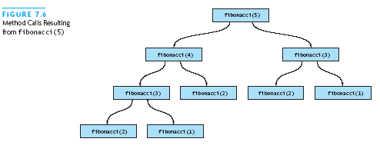
Efficiency of Recursion: Inefficient Fibonacci
This turns out to be a terrible use of recursion:
At first glance, this seems like a very clever use of recursion.
However, if the program is coded up and run for values of N around 40, it becomes apparent that this program is terribly inefficient
# calls apparently
O(2^{n}) – big!
Inefficient … WHY ???

Slide 21
Efficient Fibonacci
Strategy: keep track of:
Current Fibonacci number
Previous Fibonacci number
# left to compute
public static int fibStart (int n) {
return fibo(1, 0, n);
}
private static int fibo (int curr, int prev, int n)
{
if (n <= 1)
return curr;
else
return fibo(curr+prev, curr, n-1);
}

Slide 22
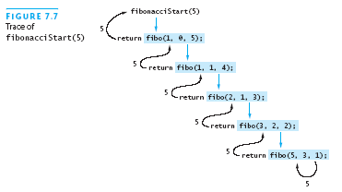
Efficient Fibonacci: A Trace
Performance is O(n)

Slide 23
Example 4: Fibonacci number w/o recursion
//Calculate Fibonacci numbers iteratively
int fib(int n)
{
int f[100];
f[0] = 0; f[1] = 1;
for (int i=2; i<= n; i++)
f[i] = f[i-1] + f[i-2];
return f[n];
}
much more efficient than recursive solution
WHY ???

Slide 24
Recursive Definitions: Greatest Common Divisor
Definition of gcd(m, n), for integers m > n > 0:
gcd(m, n) = n, if n divides m evenly
gcd(m, n) = gcd(n, m % n), otherwise
public static int gcd (int m, int n) {
if (m < n)
return gcd(n, m);
else if (m % n == 0) // could check n>0
return n;
else
return gcd(n, m % n);
}

Slide 25
SORTING MERGE SORT

Slide 26
Mergesort
Mergesort is one of the earliest algorithms proposed for sorting. According to Donald Knuth, it was proposed by John von Neumann as early as 1945.
1. Divide the input array into two subarrays of roughly equal size.
2. Recursively mergesort each of the subarrays.
3. Merge the newly-sorted subarrays into a single sorted array.
The first step is completely trivial—we only need to compute the median array index—and we can delegate the second step to the Recursion Fairy.
All the real work is done in the final step;
the two sorted subarrays can be merged using a simple linear-time algorithm.
The heart of mergesort algorithm is the merging of two already sorted arrays.
Merging two sorted arrays A and B creates a third array C that contains all the elements of A and B arranged in sorted order.

Slide 27
Mergesort
void MergeSort(int A[], int s, int e) {
if (s < e) {
int mid = (s + e) / 2;
MergeSort(A, s, mid);
MergeSort(A, mid + 1, e);
Merge(A, s, mid, e);
}
void Merge(int A[], int s, int m, int e) {
int i = s, j = m + 1;
int * tmp = new int[e - s + 2];
for (int k = 1; k <= e - s + 1; k++) {
if (i > m)
tmp[k] = A[j++];
else if (j > e)
tmp[k] = A[i++];
else if (A[i] < A[j])
tmp[k] = A[i++];
else
tmp[k] = A[j++];
}
int k = 1;
for (int i = s; i <= e; i++)
A[i] = tmp[k++];
}

Slide 28
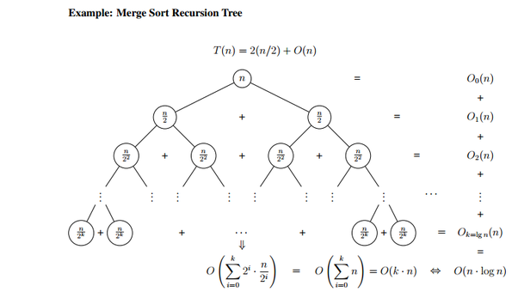

Slide 29
Recursive Definition of Linked List
A linked list is either:
An empty list ← the base case, or
A head node, consisting of: ← recursive case
A data item and
A reference to a linked list (rest of list)

Slide 30
Recursive Linked List --Size
private int size (Node<E> * ptr) {
if (ptr == null)
return 0;
else
return 1 + size(ptr->next);
}
public int size () {
return size(head);
}

Slide 31
Recursive Linked List Find
private Node<E> find(Node<E> *ptr, E data) {
if (ptr == null)
return null;
else if (data.equals(ptr->data))
return ptr;
else
return find(ptr->next, data);
}
public boolean contains (const E data) {
return find(head, data) != null;
}

Slide 32
ADD Recursive Linked List
private void add (Node<E> *ptr, E data) {
// Note different base case!!
if (ptr->next == null)
ptr->next = new Node<E>(data);
else
add(ptr->next, data);
}
public void add (E data) {
if (head == null)
head = new Node<E>(data);
else
add(head, data);
}

Slide 33
Practice Questions
Develop Recursive Functions for following problems
Array
Reverse items of an array
Find Length of the array
Find sum of all the elements in the array
Find if given string is palindrome
For a given character recursively
a. Check if it is in a string.
b. Count all of its occurrences in a string.
c. Remove all of its occurrences from a string.
Determinine if a given string s has more vowels than consonants.

Slide 34
Practice Questions
Develop Recursive Functions for following problems
Linked List (do for both singly and doubly linked list)
Reverse the list
Remove an element from the list
Remove the all occurrences of given element in the list
Search for an element
Replace an element with the given number
Find indexOf the particular element in the list

Slide 35
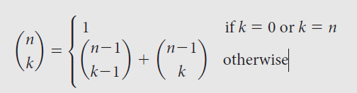
Practice Questions
Recursive Mathematical Functions
Write a recursive function to compute GCD
Write a recursive method that for a positive integer n prints odd numbers
a. between 1 and n
b. between n and 1
Write a recursive method that for a positive integer returns a string with commas in the appropriate places, for example, putCommas(1234567) returns the string “1,234,567.”
Write a recursive function to compute the binomial coefficient according to the definition

Slide 36
Practice Questions
Write a recursive function to add the first n terms of the series
1 + 1/2 - 1/3 + 1/4 - 1/5
Write a recursive C++ program that will output all subsets of size two of a set of n elements (without repeating any subsets).
Now extend the above program to output all the subsets of a set of n elements.
Write a recursive algorithm that gets an integer n and integer array A as input and check if the given array A contains two integers, such that N = A[i]+A[j].

Slide 37
What does the following code do
int Function(int A[], int i, int n){
if n = 1
return A[i]
return Function(A, i,⌈n/2⌉) + Function(A, i+⌈n/2⌉,⌊n/2⌋)
}
Make the recursion tree of the above function
Notes:
Output: The sum of the n integers in A starting at index i

